Slide 1
Statistical problems - data presentations
Numerical summaries of data

Slide 2
how to use Oak lessons

Slide 3
I can choose appropriate representations to explore a statistical problem.

Slide 4
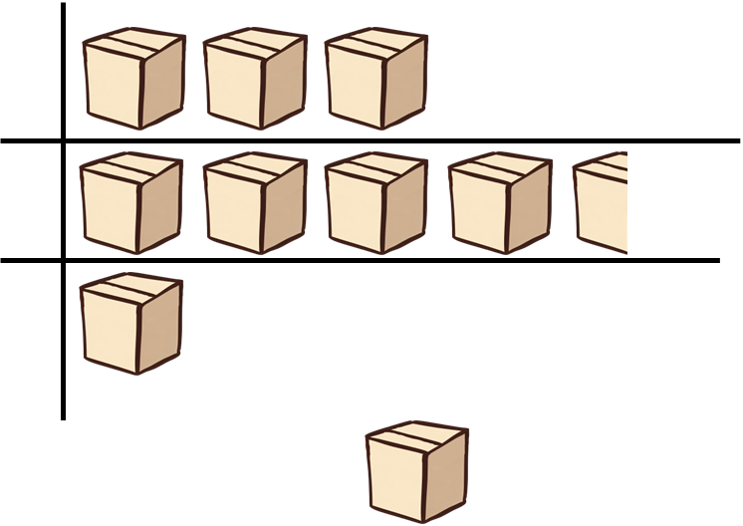
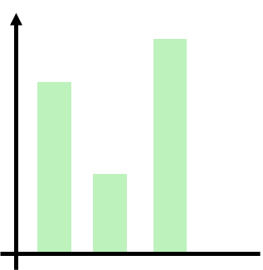
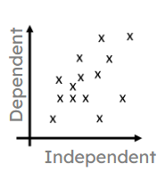

A pictogram (pictograph) is a graph consisting of pictures to visually represent the frequency of objects or groups.
categories
= 5 boxes
A bar chart (bar graph) is a graph consisting of bars visually representing the frequency of objects or groups.
frequency
categories
A scatter graph is a visual representation for bivariate data. It can be useful when determining the nature of the relationship between the variables.
A pie chart (pie graph) is a circular graph where sectors represent different groups proportionally.

Slide 5

Statistical problems - data presentations
Presenting data clearly using graphs
Choosing how to present data to illustrate a point

Slide 6

Presenting data clearly using graphs
Visual representations can be helpful when analysing data and when communicating messages about the data to others.
Planning the statistical enquiry and asking a question
Outcomes and actions
Collection of data
data cycle
Organisation and presentation of data
Interpretation of the data
Analysis of the data

Slide 7
Presenting data clearly using graphs
With any graph we use, it is important that it is presented in a way that makes it clear to see what the data is showing.
Using the available space effectively can help make elements of the graph clear to see and interpret accurately.
The scale on the axes can drastically affect how a graph looks.
With some graphs it is important that the scales of the axes start at zero because it represents the data more accurately.
With other graphs, starting at zero can cause problems.

Slide 8
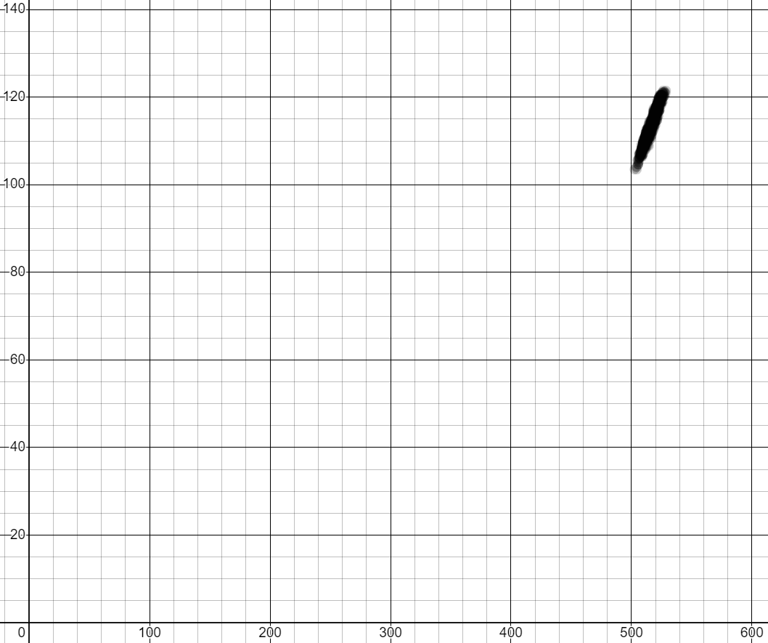
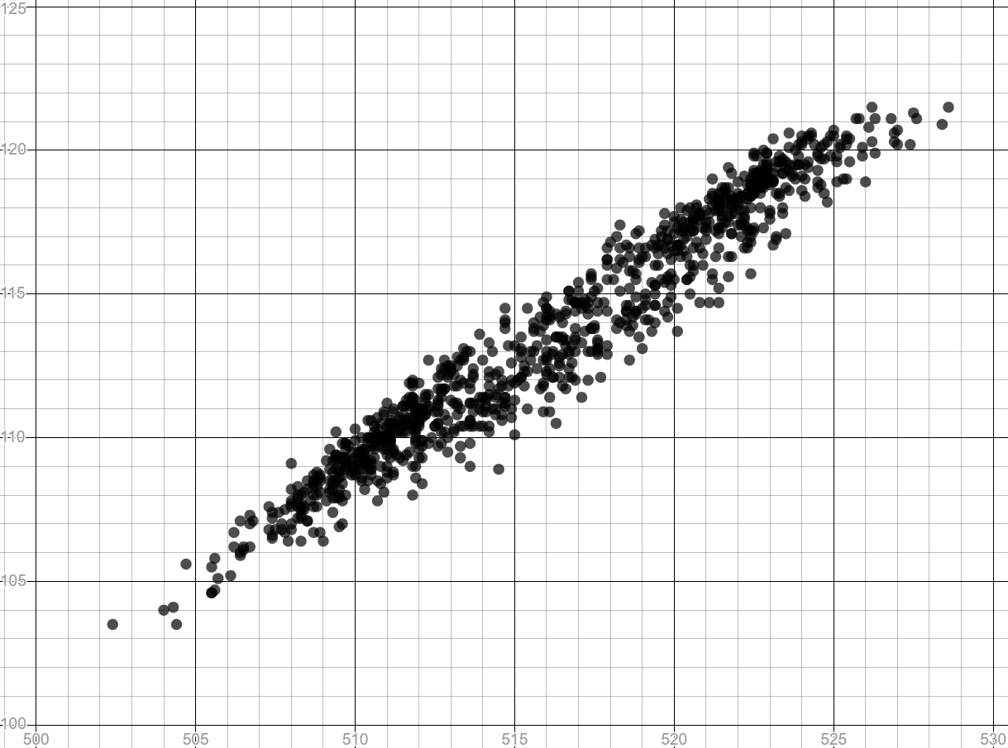
Presenting data clearly using graphs
For scatter graphs, starting each axis at zero can cause the points to become clusters in a small space.
Starting the scales of a scatter graph away from zero can sometimes make more use of the space and illustrate correlations more clearly.
125
120
120
100
80
115
60
110
40
105
20
0
100
0
200
400
600
500
510
520
530

Slide 9
Presenting data clearly using graphs
Sometimes a graph will use an axis break to highlight that its scale does not start at zero.
125
120
115
110
105
axis break
510
520
530
axis break

Slide 10
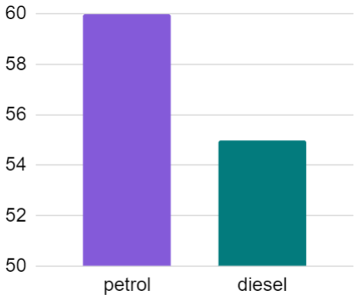
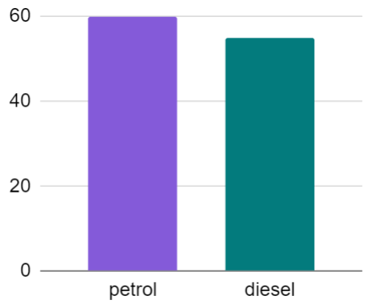
Presenting data clearly using graphs
For bar charts, not starting the vertical axis at zero distorts how large one bar is compared to the other.
In the bar chart below, it looks like there are twice as many people using petrol cars than diesel cars.
This does not accurately represent the data.
Starting at zero gives a more accurate picture of how the groups compare.
frequency
frequency

Slide 11
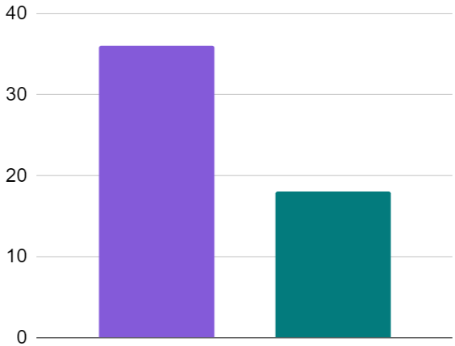
Presenting data clearly using graphs
Labelling axes can help a reader understand what the data is about and what each part of the graph represents.
The bar chart shows weather data for 2021 from The Met Office.
Is it clear what data this bar chart is showing?
no
days with airfrost
How could it be clearer?
label each axis
Sheffield
Tiree

Slide 12

Presenting data clearly using graphs
The scales of a scatter graph should always start at zero.
Not starting at zero can make it clearer to see connections between variables.
Starting at zero can accurately represent how values of data compare with each other.

Slide 13

Florence Nightingale
Florence Nightingale was one of the early pioneers who represented statistics using diagrams.
For many people in the 19th century, large tables of statistics would be impossible to understand.
Using pictorial representations made her data easier to digest.
Florence’s work led to her becoming the first woman to be elected to the Royal Statistics Society in 1858.
Notes:
Y8U7L17

Slide 14
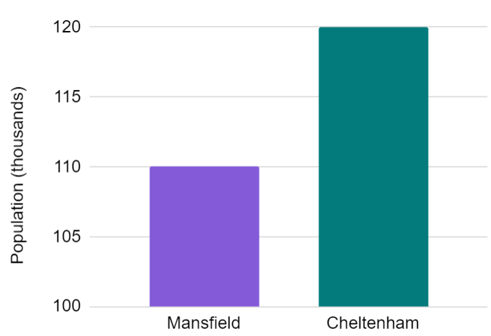

Presenting data clearly using graphs
1) The graph shows data from the ONS about the population of two towns in 2019.
Cheltenham has twice as many people as Mansfield.
Izzy
a) Explain why Izzy might think this, based on the bar chart.
b) Explain why this is wrong.

Slide 15
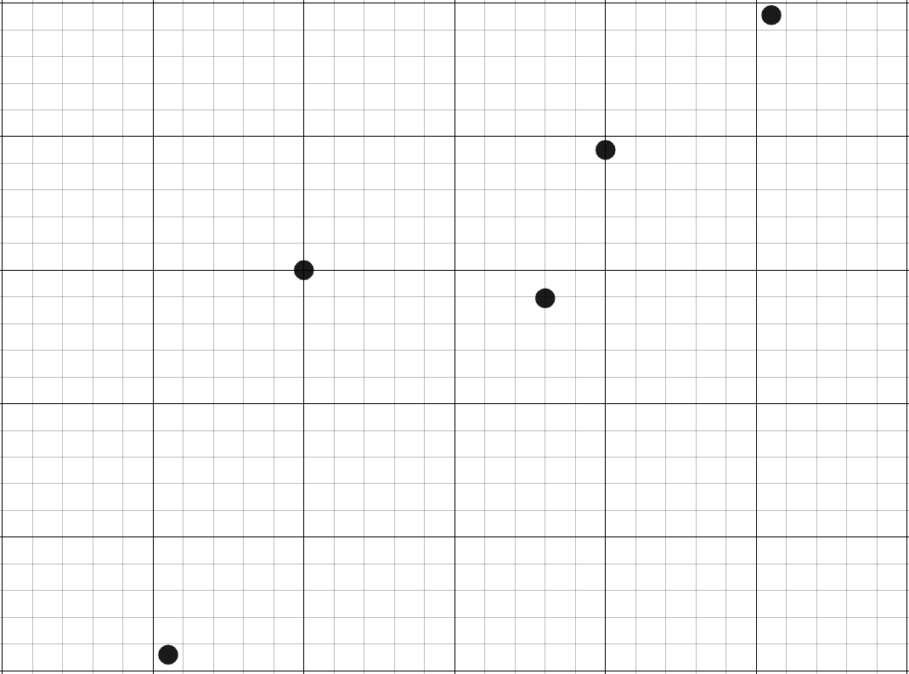
Presenting data clearly using graphs
2) The table shows data from the ONS about five towns in 2019.
Complete the scale on the axes of the scatter graph.
2500
population (thousands) | number of properties sold
131 | 2012
140 | 2300
156 | 2279
160 | 2390
171 | 2491
number of properties sold
180
population (thousands)

Slide 16
Presenting data clearly using graphs
1) The graph shows data from the ONS about the population of two towns in 2019.
Cheltenham has twice as many people as Mansfield.
Izzy
a) Explain why Izzy might think this, based on the bar chart.
The bar for Cheltenham is twice as long as the bar for Mansfield.
b) Explain why this is wrong.
The scale does not start at zero. There are 110 thousand people in Mansfield and 120 thousand people in Cheltenham.

Slide 17
Presenting data clearly using graphs
2) The table shows data from the ONS about five towns in 2019.
Complete the scale on the axes of the scatter graph.
2500
population (thousands) | number of properties sold
131 | 2012
140 | 2300
156 | 2279
160 | 2390
171 | 2491
2400
2300
number of properties sold
2200
2100
2000
120
130
140
150
160
170
180
population (thousands)

Slide 18
Statistical problems - data presentations
Presenting data clearly using graphs
Choosing how to present data to illustrate a point

Slide 19
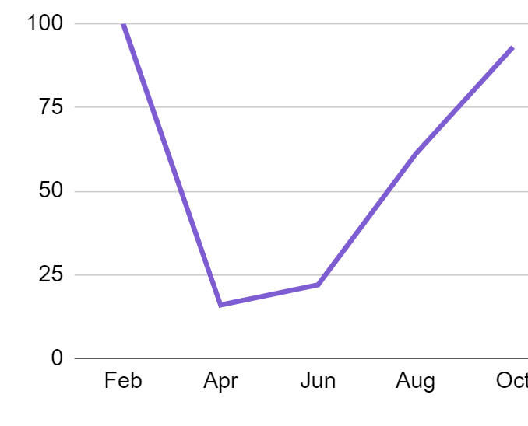
Choosing how to present data to illustrate a point
The usefulness of a graph can depend on the type of data that you are working with and the conclusion that you are trying to illustrate.
frequency
categories
bar chart
pie chart
scatter graph
line graph
What could be the advantages and disadvantages for using each graph?

Slide 20
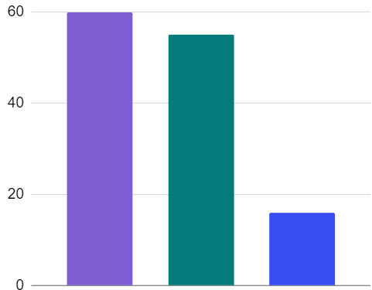
Choosing how to present data to illustrate a point
Bar charts and pie charts can be useful for data involving frequencies of different categories.
fuel-type | frequency
petrol | 60
diesel | 55
electric | 16
electric
petrol
diesel
petrol
diesel
electric
In which graph is it easier to compare the frequencies of petrol and diesel?

Slide 21
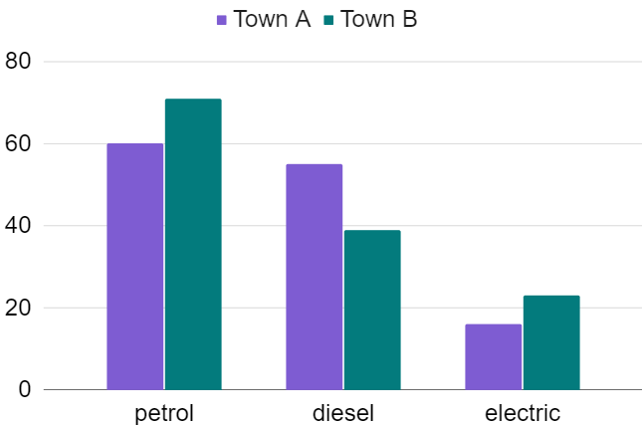
Choosing how to present data to illustrate a point
Comparative bar charts can be used to compare data from two different groups when their total frequencies are roughly equal.
fuel-type | Town A frequency | Town B frequency
petrol | 60 | 71
diesel | 55 | 39
electric | 16 | 23
Town B use fewer diesel cars and more electric cars than Town A.

Slide 22
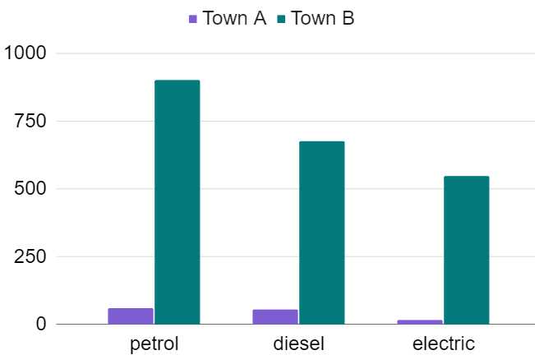
Choosing how to present data to illustrate a point
Comparative bar charts can be less useful for making comparisons between datasets that have drastically different total frequencies.
fuel-type | Town A frequency | Town B frequency
petrol | 60 | 901
diesel | 55 | 675
electric | 16 | 548
The sample of data taken in Town B was much bigger than in Town A.

Slide 23
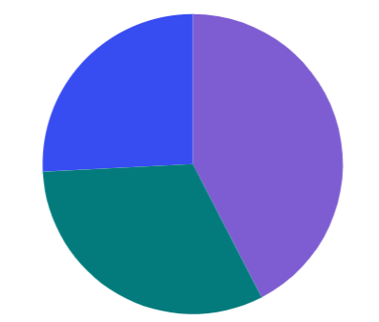
Choosing how to present data to illustrate a point
Pie charts can be useful when making comparisons between datasets that have different total frequencies.
Pie charts show frequencies in proportion to the amount of data in each set.
Town A
Town B
electric
electric
petrol
petrol
diesel
diesel
The proportion of cars that use diesel is less in Town B than in Town A.

Slide 24
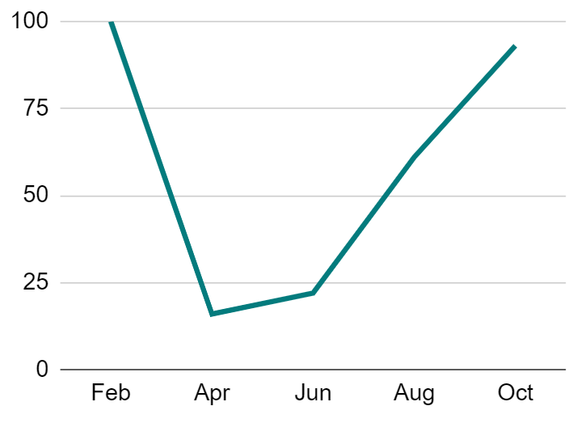
Choosing how to present data to illustrate a point
Line graphs can be useful for showing how a variable changes over time.
The table below shows weather data from the Met Office.
month | total rainfall (mm)
Feb | 100
Apr | 16
Jun | 22
Aug | 61
Oct | 93
total rainfall (mm)
month

Slide 25
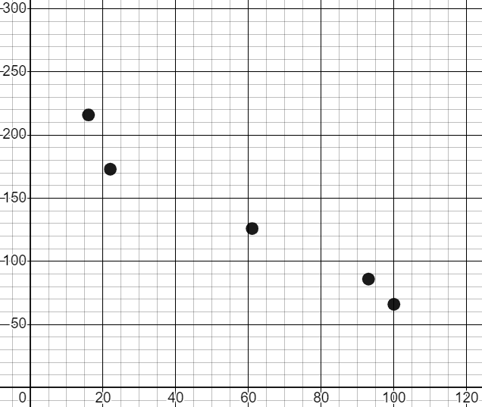
Choosing how to present data to illustrate a point
Scatter graphs can be useful for showing whether a relationship exists between two different variables in data that is bivariate.
The table below shows weather data from the Met Office.
month | total rainfall (mm) | sunshine (hrs)
Feb | 100 | 66
Apr | 16 | 216
Jun | 22 | 173
Aug | 61 | 126
Oct | 93 | 86
sunshine (hours)
total rainfall (mm)

Slide 26

Choosing how to present data to illustrate a point
Scatter graphs are less useful for data involving frequencies of different categories.
fuel-type | Town A frequency | Town B frequency
petrol | 60 | 901
diesel | 55 | 675
electric | 16 | 548
?
?
A bar chart or pie chart would be more appropriate for this data.

Slide 27
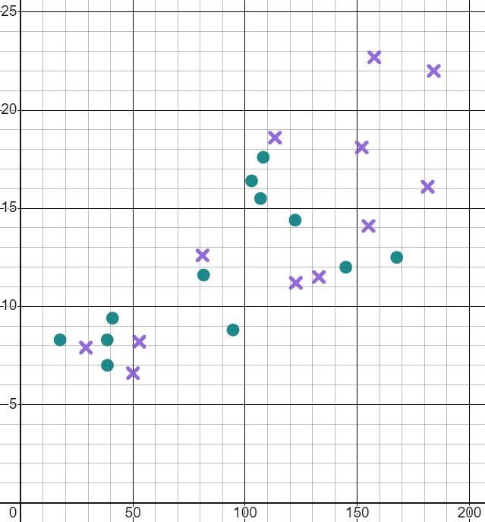
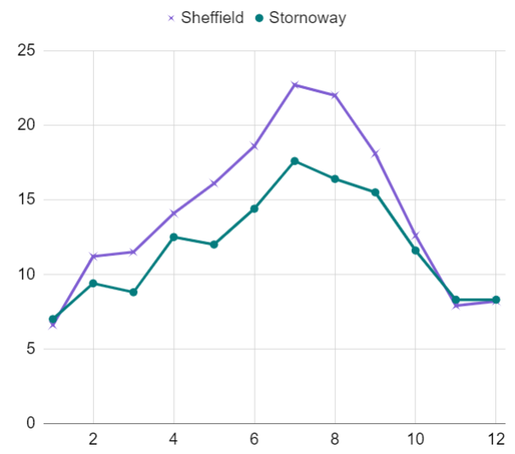
Choosing how to present data to illustrate a point
The graphs show data from the Met Office about the weather in Sheffield ( ) and Stornoway ( ) for each month in 2019.
mean daily maximum temperature (℃)
mean daily maximum temperature (℃)
total sunshine duration (hrs)
month
Which graph shows most clearly that Sheffield is often warmer than Stornoway?
the line graph

Slide 28
Choosing how to present data to illustrate a point
The graphs show data from the Met Office about the weather in Sheffield ( ) and Stornoway ( ) for each month in 2019.
mean daily maximum temperature (℃)
mean daily maximum temperature (℃)
total sunshine duration (hrs)
month
Which graph shows most clearly that warmer months have more sunshine?
the scatter graph

Slide 29
Choosing how to present data to illustrate a point
A bar chart is always clearer than a pie chart.
You can compare the frequencies of categories within a dataset more easily with a bar chart.
You can compare the proportions of categories between datasets of different sizes more easily with a pie chart.

Slide 30
Choosing how to present data to illustrate a point
Which graph is the most useful for illustrating a connection between two variables in bivariate data?
bar chart
line graph
pie chart
scatter graph

Slide 31
Choosing how to present data to illustrate a point
Which graph is the most useful for illustrating how a single variable has changed over time?
bar chart
line graph
pie chart
scatter graph

Slide 32

Choosing how to present data to illustrate a point
Some representations can be useful to illustrate the context of the data.
Pictograms are similar to bar charts but use pictures instead of bars to illustrate what the data is about.
month 1
month 2
month 3
Key = 20 bikes
What could the context of the data in this pictogram be?
e.g. number of bikes sold per month by a shop

Slide 33
Choosing how to present data to illustrate a point
Pictograms are less useful when you need to divide pictures up precisely to represent frequencies accurately.
Presenting 17 bikes sold in month 4 would be difficult using this pictogram.
month 1
month 2
month 3
month 4
Key = 20 bikes
What other type of graph could be used instead?
e.g. bar chart, pie chart, line graph

Slide 34
Choosing how to present data to illustrate a point
Infographics are sometimes used to present data in a way that illustrates its context. These are not strictly graphs but they can help people visualise data.
Product A
Product B
82%
37%
What could the context of the data in this infographic be?
e.g. percentage of people who said they would recommend each product

Slide 35



Choosing how to present data to illustrate a point
The infographic below is based on data from the ONS about Leeds in 2015.
What could this data be about?
greenhouse gas emissions
from industry, homes and transport
1638.2 kt CO2e
1310.8 kt CO2e
613.5 kt CO2e
What conclusions does it show?
Most emissions came from transport.

Slide 36
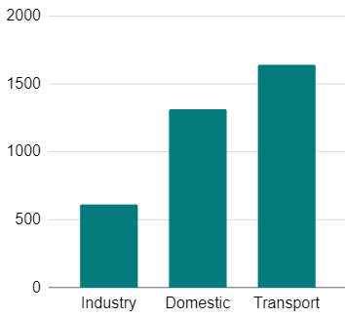
Choosing how to present data to illustrate a point
The sizes of images in infographics are sometimes scaled to match the numbers but not always. Sometimes images are not to scale, as their purpose is to simply highlight which numbers are bigger than others.
A bar chart could be more useful when accuracy is important.
1638.2 kt CO2e
1310.8 kt CO2e
greenhouse gas emissions (kt CO2e)
613.5 kt CO2e

Slide 37

Choosing how to present data to illustrate a point
The infographic below is based on data from The Met Office about Lowersoft in 2008.
winter
spring
summer
autumn
119 mm
144 mm
187 mm
257mm
What could the data be about?
amount of rainfall during each season

Slide 38
Choosing how to present data to illustrate a point
Starting with the lowest, sort the seasons according to their amounts of rainfall.
winter
spring
summer
autumn
119 mm
144 mm
187 mm
257mm
winter, summer, spring, autumn

Slide 39

Choosing how to present data to illustrate a point
1) The table shows weather data from The Met Office for Cardiff in 1995.
month | sunshine duration (hours)
1 | 41
3 | 158
5 | 233
7 | 222
9 | 168
11 | 84
Plot a graph to illustrate how the duration of sunshine changed during the year.

Slide 40

Choosing how to present data to illustrate a point
2) The table shows weather data from The Met Office for Cardiff in 1995.
sunshine duration (hours) | max daily temperature mean (℃)
41 | 9
158 | 11
233 | 17
222 | 23
168 | 18
84 | 12
Plot a graph to illustrate the relationship between sunshine duration and maximum temperature.

Slide 41

Choosing how to present data to illustrate a point
3) The table shows weather data from The Met Office for four locations in 1995.
location | days with airfrost
Ballypatrick Forest | 23
Cardiff | 33
Durham | 64
Lerwick | 59
Plot a graph to illustrate how the total number of days with airfrost differs between the four locations.

Slide 42
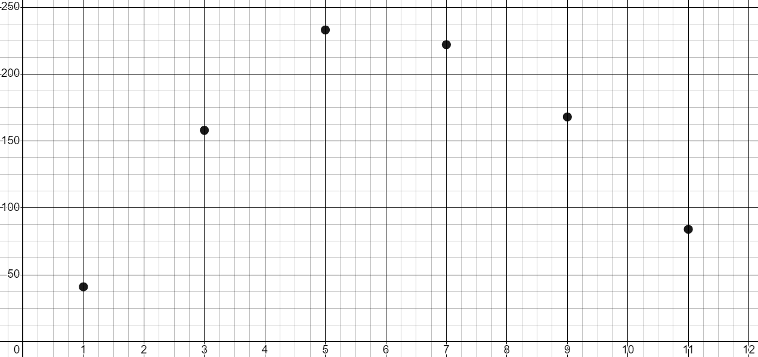
Choosing how to present data to illustrate a point
1) The table shows weather data from The Met Office for Cardiff in 1995.
month | sunshine duration (hours)
1 | 41
3 | 158
5 | 233
7 | 222
9 | 168
11 | 84
Plot a graph to illustrate how the duration of sunshine changed during the year.
sunshine duration (hrs)
month

Slide 43
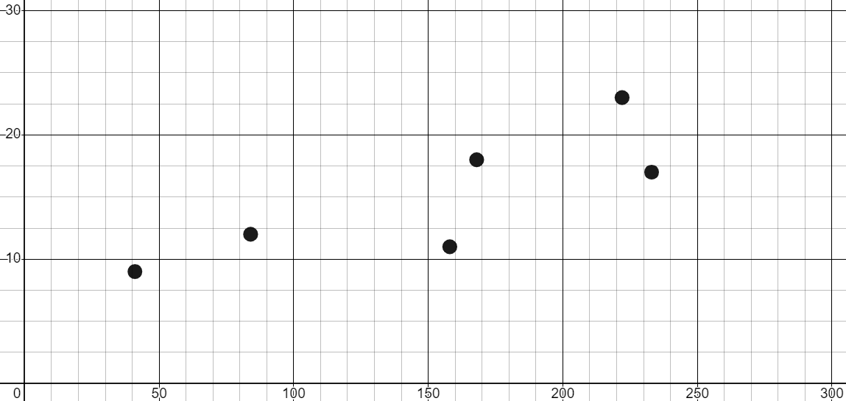
Choosing how to present data to illustrate a point
2) The table shows weather data from The Met Office for Cardiff in 1995.
sunshine duration (hours) | max daily temperature mean (℃)
41 | 9
158 | 11
233 | 17
222 | 23
168 | 18
84 | 12
Plot a graph to illustrate the relationship between sunshine duration and maximum temperature.
max daily temperature mean (℃)
sunshine duration (hrs)

Slide 44
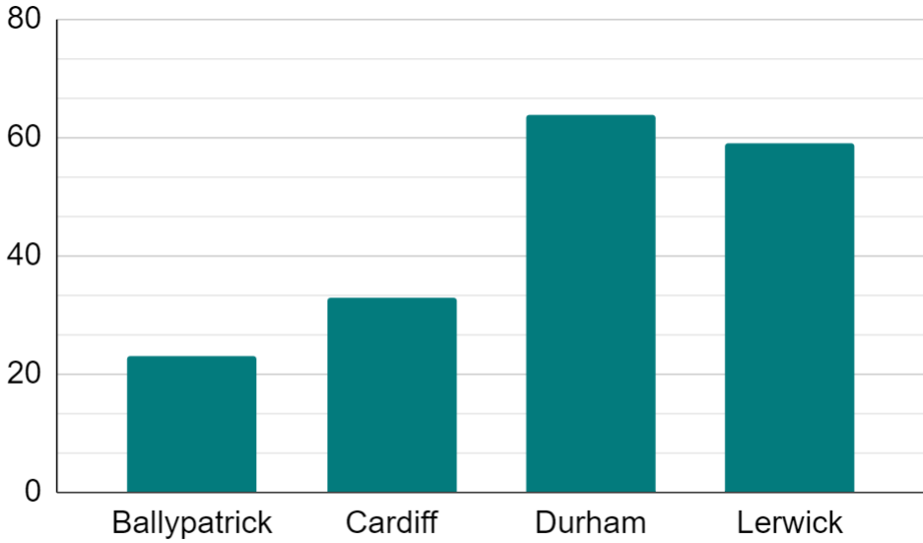
Choosing how to present data to illustrate a point
3) The table shows weather data from The Met Office for four locations in 1995.
location | days with airfrost
Ballypatrick Forest | 23
Cardiff | 33
Durham | 64
Lerwick | 59
Plot a graph to illustrate how the total number of days with airfrost differs between the four locations.
days with airfroost
location

Slide 45
Statistical problems - data presentations
Graphical representations should effectively represent the data.
Scales on axes should be chosen carefully to give a clear and accurate representation of the data.
Some graphical representations are easier to understand than others.
An appropriate graphical representation should be chosen to clearly illustrate the conclusion you wish to communicate.

Slide 46

© Oak National Academy 2023.
Produced in partnership with Mathematics in Education and Industry.
Licensed on the Open Government Licence v3.0, except where otherwise stated. See Oak terms and conditions.

